Slide 1
Evaluating ROVIO and OKVIS – two Visual-Inertial Odometry Approaches
Julian Surber
Semester Thesis
Supervised by Margarita Chli & Lucas Pinto Teixeira

Slide 2
Intro
Sample Application(s)
E.g. Aeroworks, GPS loss

Slide 3
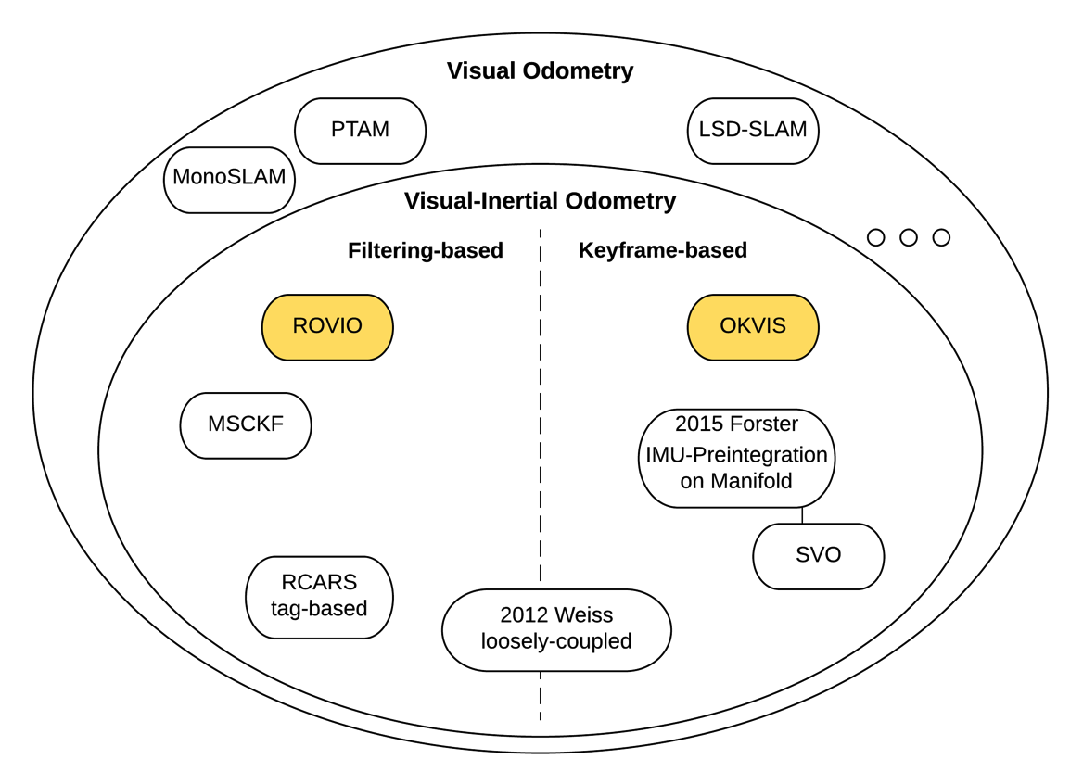

Slide 4
ROVIO – Robust Visual Inertial Odometry Using a Direct EKF-Based Approach

Slide 5
OKVIS – Optimal Keyframe-Based Visual Inertial SLAM

Slide 6
VI Sensor

Slide 7
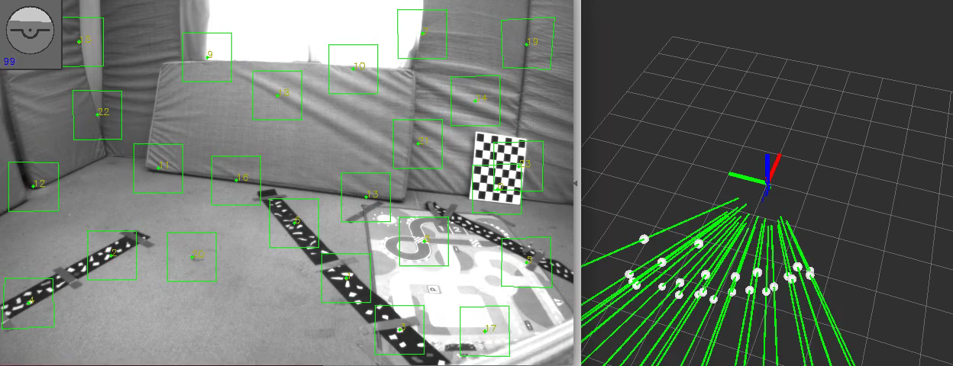
Short Trajectory

Slide 8
Evaluation Sheme
Local Accuracy
Local Translation Error
Local Orientation Error
Global Accuracy
Absolute Translation Error
Absolute Orientation Error
World-Z Error
Yaw Error
Computational Complexity
Processing Time for a new Frame

Slide 9
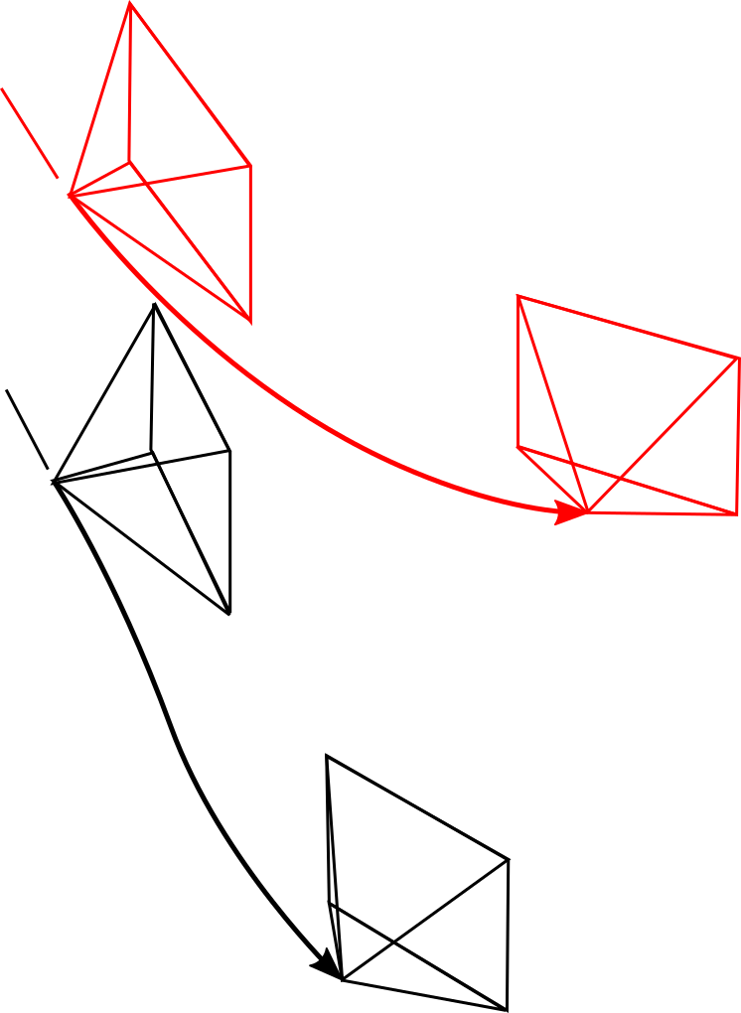

Slide 10
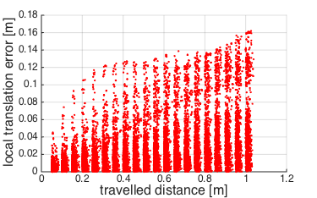
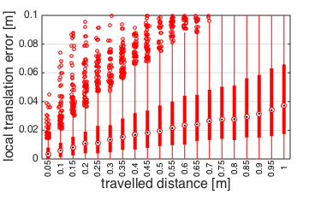
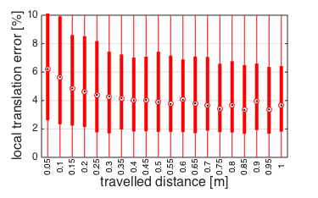
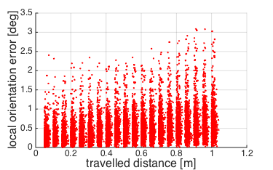
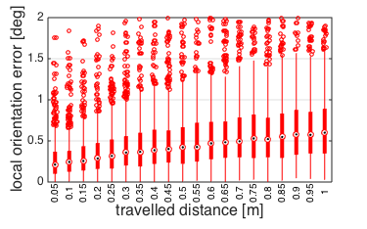
LTE = 4 cm / 1 m (4 %)
LOE = 0.6° / 1 m

Slide 11
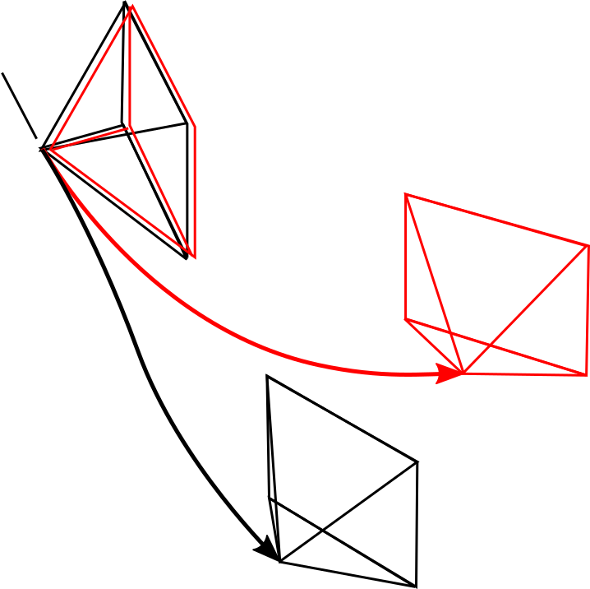

Slide 12
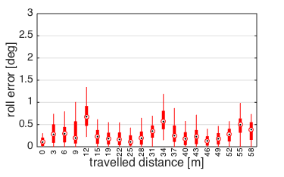
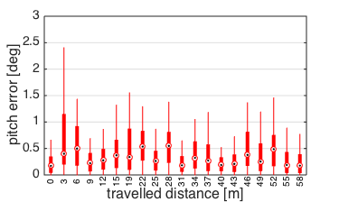
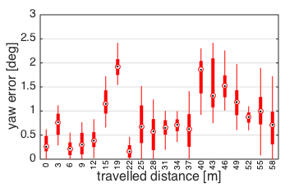
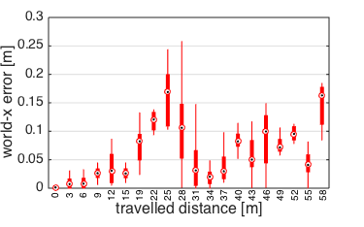
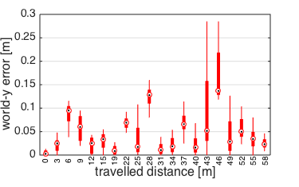
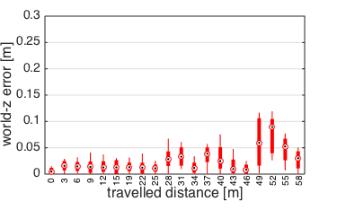
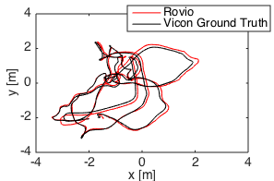
GOE_Yaw = 1 deg / 50 m
GTE_Z = 5 cm / 50 m (0.1 %)

Slide 13
Short Trajectory: Summary (create Table!)
Local Accuracy:
LTE = 4 cm / 1 m (4 %)
LOE = 0.6° / 1 m
Global Accuracy
roll and pitch errors bounded
yaw error = 1 deg / 50 m
x and y errors are driven by yaw
z error = 5 cm / 50 m (0.1 %)
Computational Complexity
Average Processing Time per Image = 10 ms

Slide 14
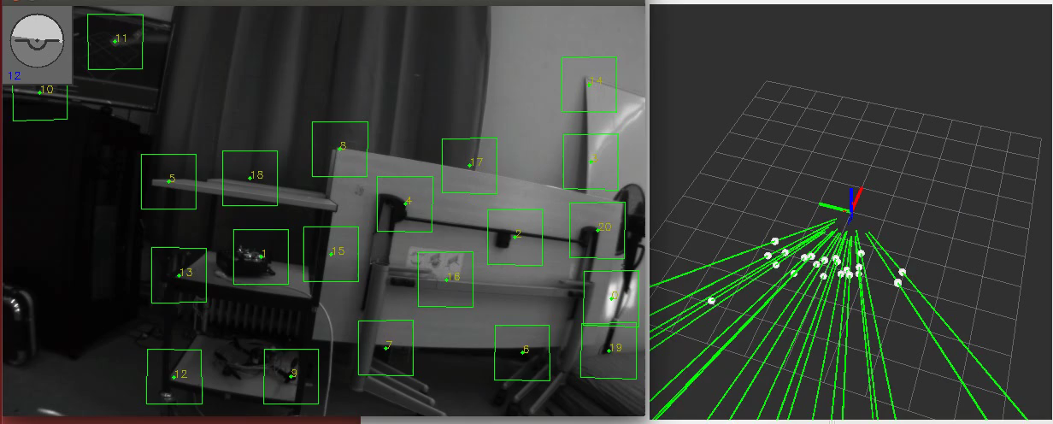
Long Trajectory

Slide 15
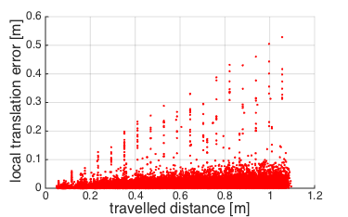
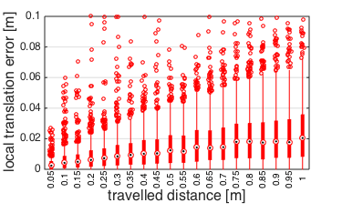
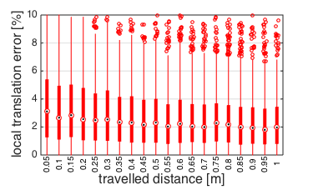
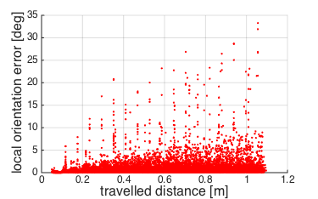
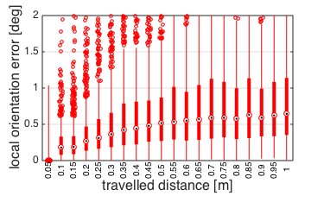
LTE = 2 cm / 1 m (2 %)
LOE = 0.6° / 1 m

Slide 16
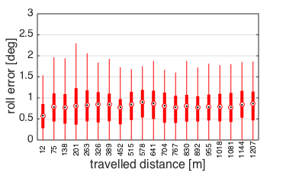
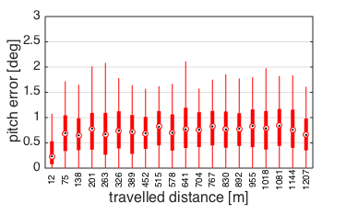
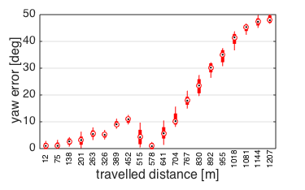
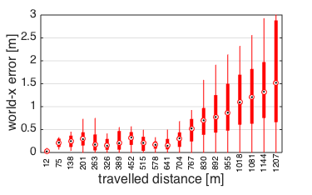
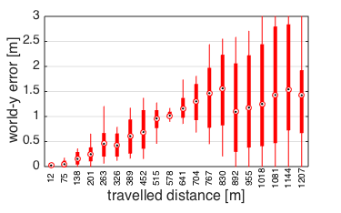
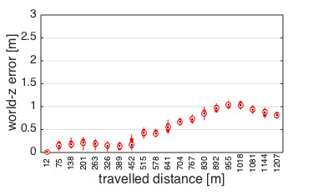
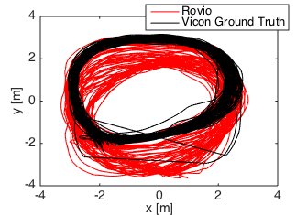
GOE_Yaw = 45 deg / 1000 m
GTE_Z = 1 m / 1000 m (0.1 %)

Slide 17
Long Trajectory: Summary (create Table!)
Local Accuracy:
LTE = 2 cm / 1 m (2 %)
LOE = 0.6° / 1 m
Global Accuracy
roll and pitch errors bounded
yaw error = 45 deg / 1000 m
x and y errors are driven by yaw
z error = 1 m / 1000 m (0.1 %)
Computational Complexity
Average Processing Time per Image = 10 ms

Slide 18
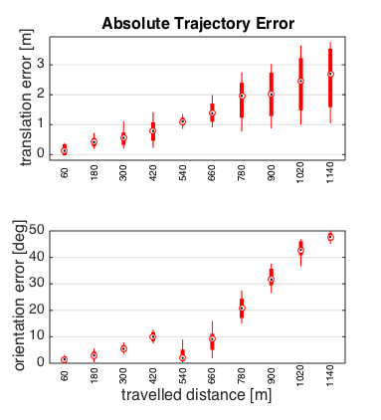

Slide 19
Results

Slide 20
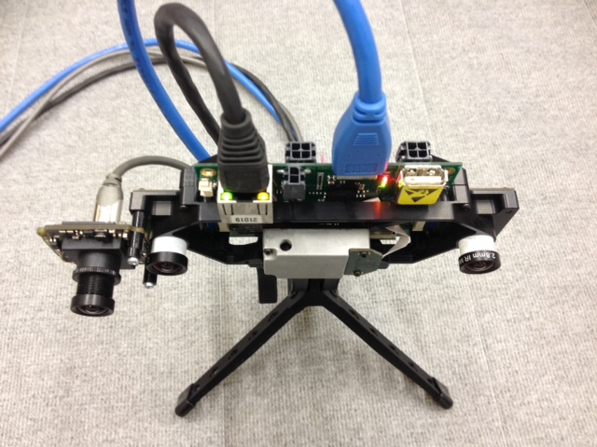
Towards non-timesynchronized Hardware
Artificial Noise on IMU-Timestamp
Real Test with VI-Sensor and Bluefox2 Camera

Slide 21
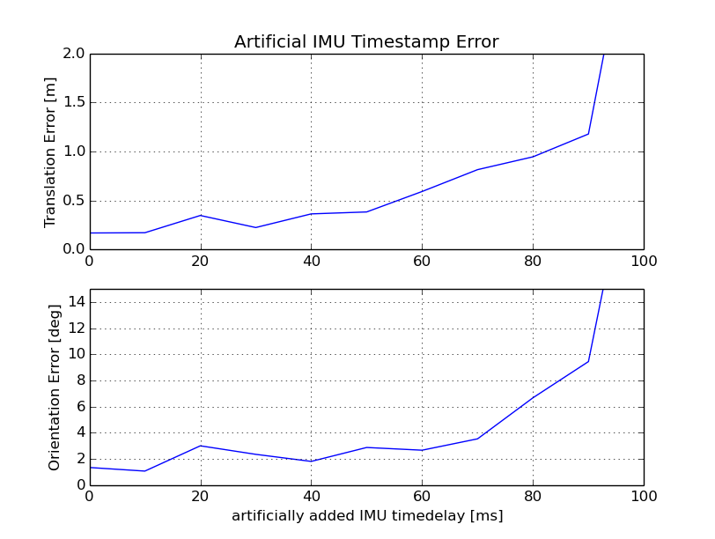
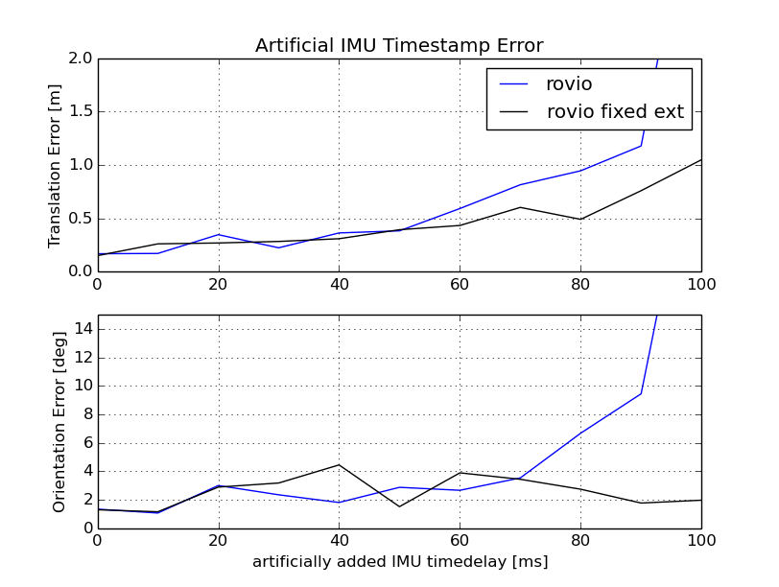
Artificial Timestamp Error

Slide 22
Slow Dataset

Slide 23
Slow Dataset

Slide 24
Fast dataset

Slide 25
Ev features

Slide 26
Summary ROVIO vs OKVIS

Slide 27
Future VI-Odometry

Slide 28
Thank you !

Slide 29
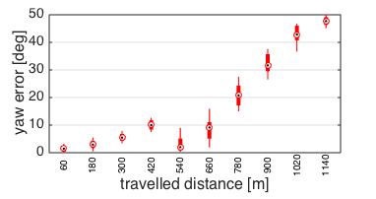
Yaw Drift
Translational Drift

Slide 31
Global Error
Thanks to gravity: Roll and Pitch Errors bounded (small)
Yaw Drift
World-X and World-Y Errors driven by Yaw Error
World-Z Drift
Local Errors cancel out → Global Error smaller than integrated local errors

Slide 33
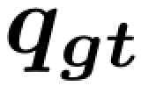
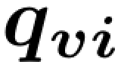
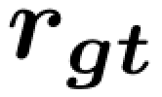
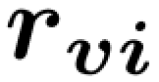
Robot
B
C
I
J

